Slide 1
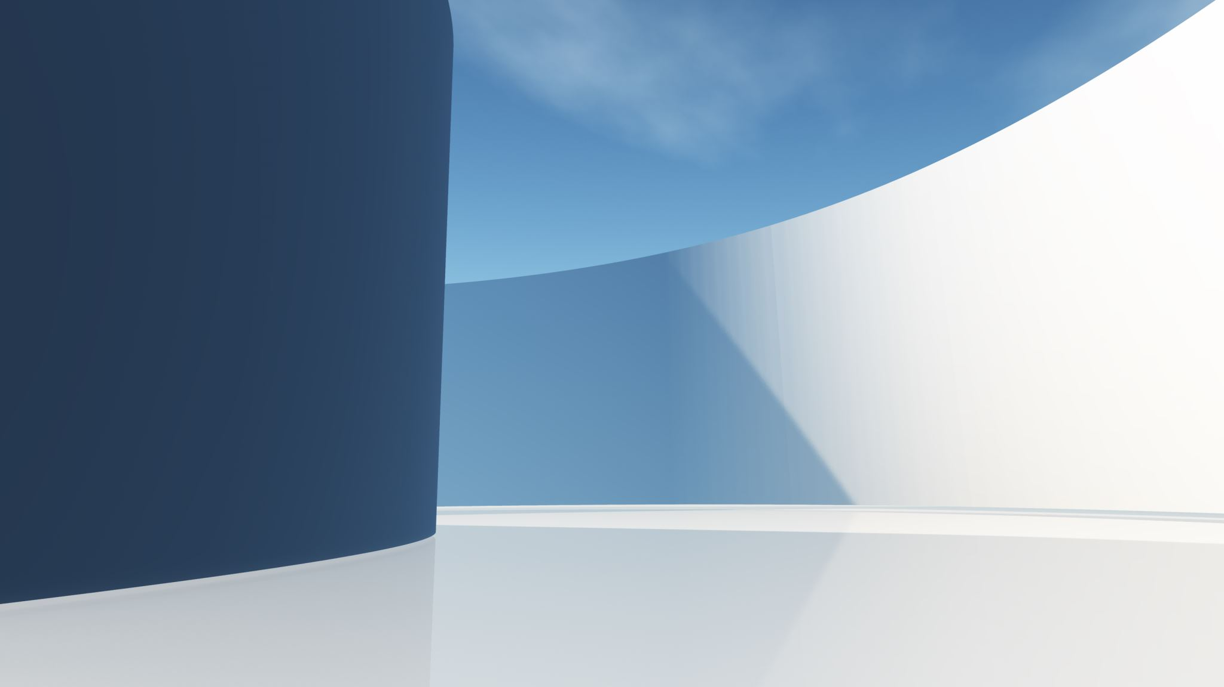
STYLE REBORN
Give your Style a New Birth

Slide 2
Style Reborn is a website designed for the purpose of Online Shopping of Fashion for Well known Stylists to present their products and for the users to purchase those products while sitting on their couch with having a cup of Tea.
As we all know that in COVID 19, it was very difficult to do shopping by visiting Malls or different Outlets when there are so many limitations by the Government and various Health Organizations implemented for our own Health Safety.
Considering above, Our team decided to provide a one window platform for online shopping of Clothes of different Stylists for users which will be good for both.
Introduction
Copyright © Style Reborn

Slide 3
ABOUT THE TEAM
Qamar Abbas
Cell no : 0335-9223315
Email : qamar2508f@aptechgdn.net
Samiullah Basit
Cell no: 0334 9940326
Email: samiullah2508f@aptechgdn.net
Muhammad Mujtaba
Cell no : 0337-4649777
Email : mujtaba2508f@aptechgdn.net
Copyright © Style Reborn

Slide 4
TOOLS AND TECHNOLOGIES USED
HTML 5
For Structure and Content Layout.
CSS 3
For Styling, Animation and Visual Design.
VS CODE
The Development Environment.
BOOTSTRAP 5
For Responsive Grid Layout.
Copyright © Style Reborn

Slide 5
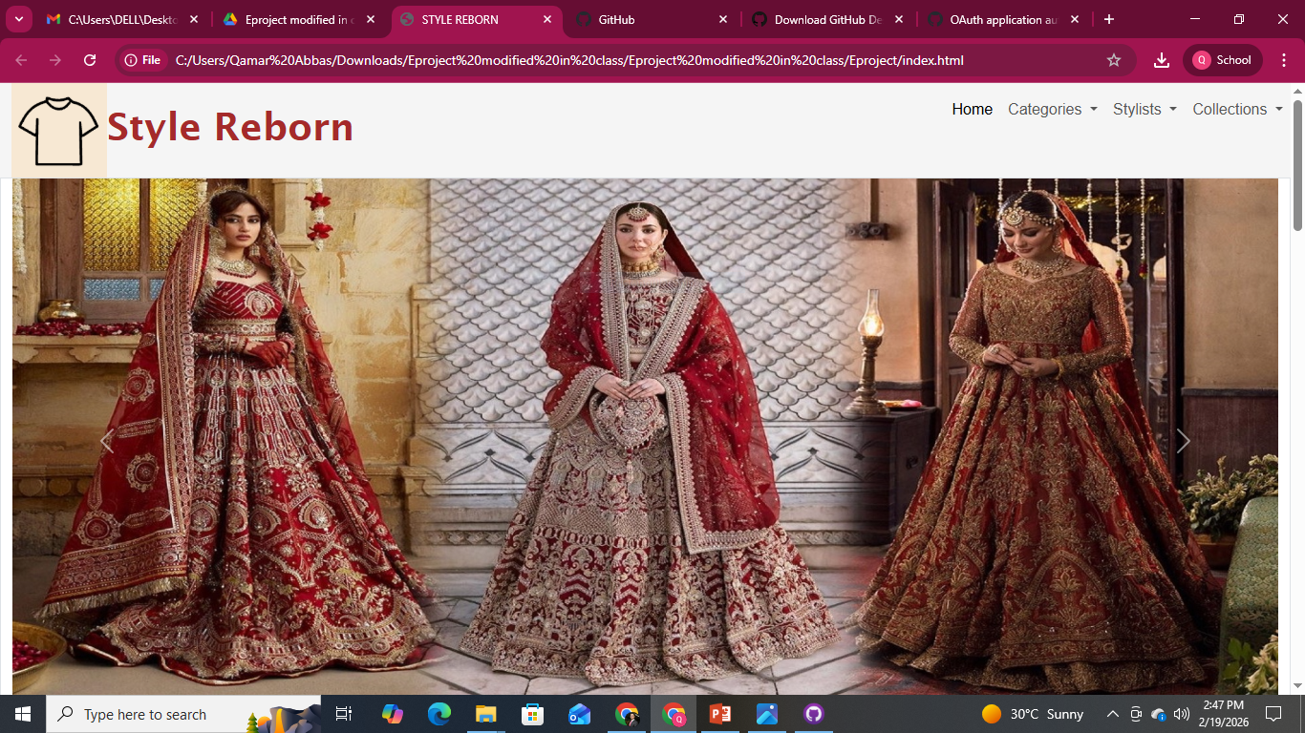
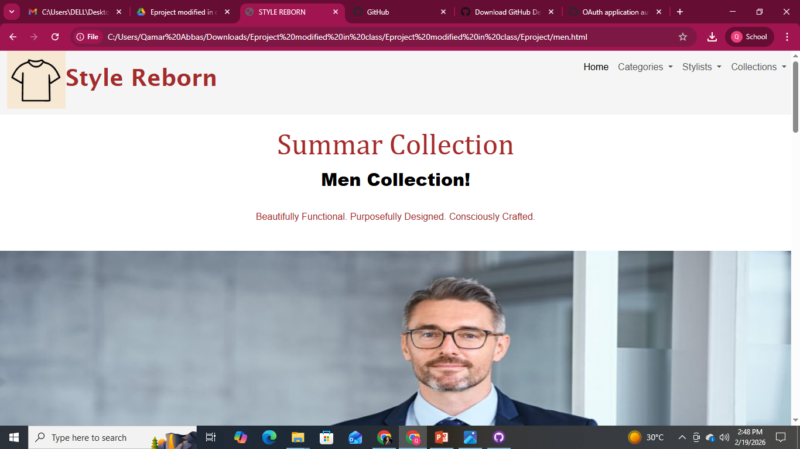
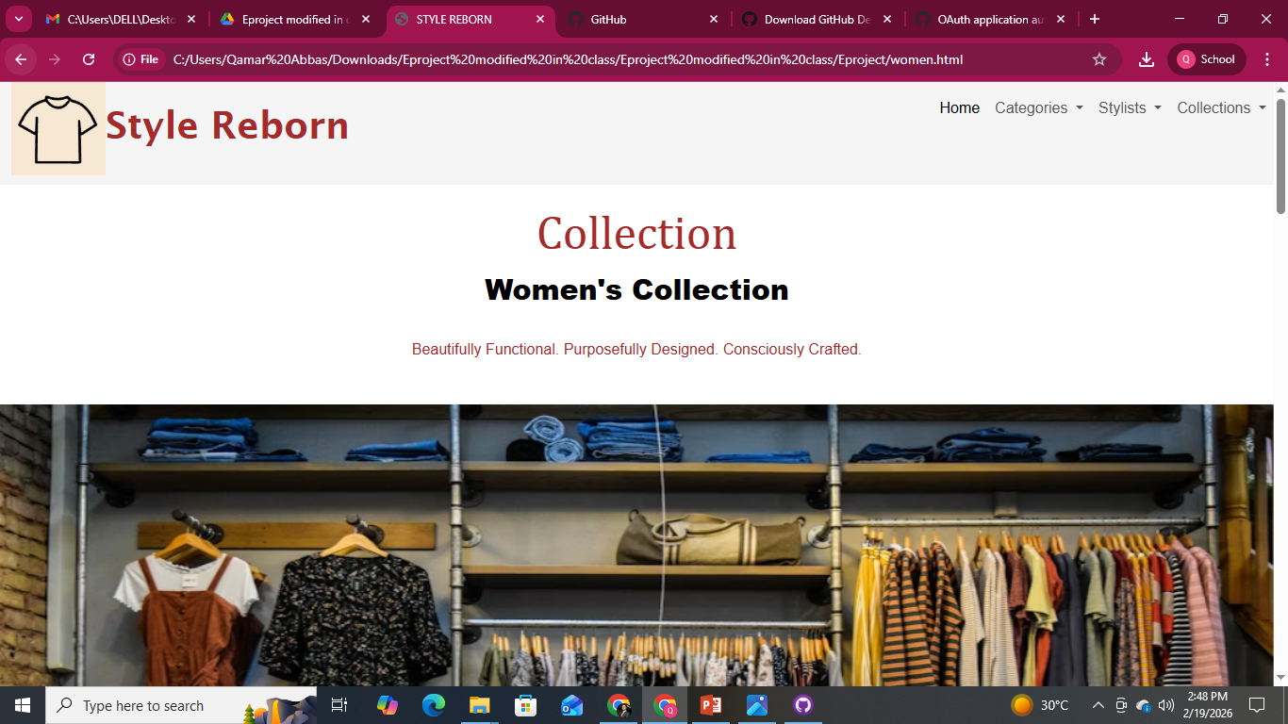
OUTPUT AND RESULTS
Copyright © Style Reborn

Slide 6
THANK YOU
Copyright © Style Reborn

